Slide 1


Slide 2

All Your Cyber Security Needs
Foundation Technology
Our new Anti-Virus protection system
December 2099

Slide 3
CS is getting increasingly important
Notes:
Title: The Digital Age Content: Our lives are increasingly digital, with critical personal and business data stored online. This digital dependence requires strong protection. Visuals: Icons of computers, smartphones, cloud storage, and a network globe.

Slide 4
We are being under attack
Constant growth of Virus Attacks!
Make a chart showcasing data, blocked attacks on one of our protected devices

Slide 5
How do we defend protect ourselfes

Slide 6
Show some example resolutions
Wall Safe

Slide 7
Brand book
#7C0DFF
#9C5EF2
#C4A2F2
#5005F2
#6CF1D6
#15D9AF
#F2F2F2
Roboto, Lato, Poppins, Open Sans, Raleway,

Slide 8
Icons

Slide 9






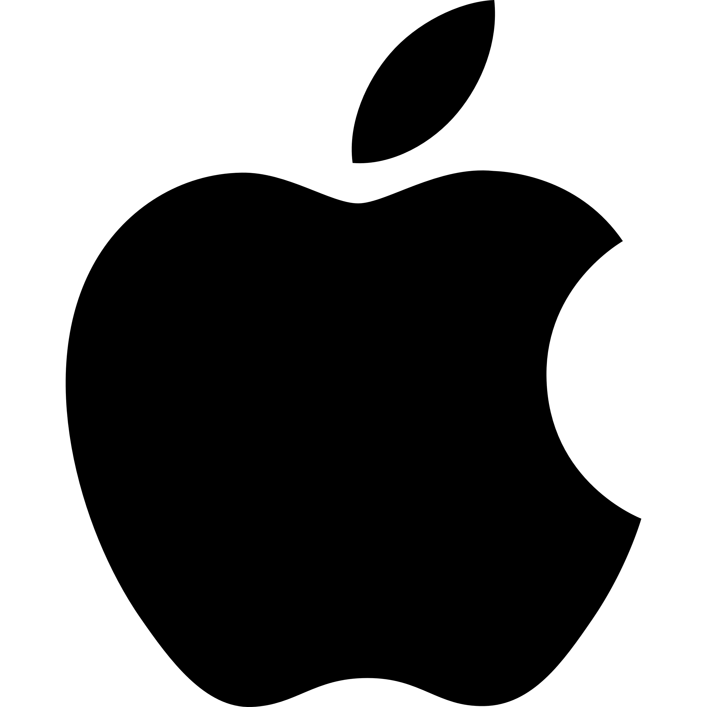





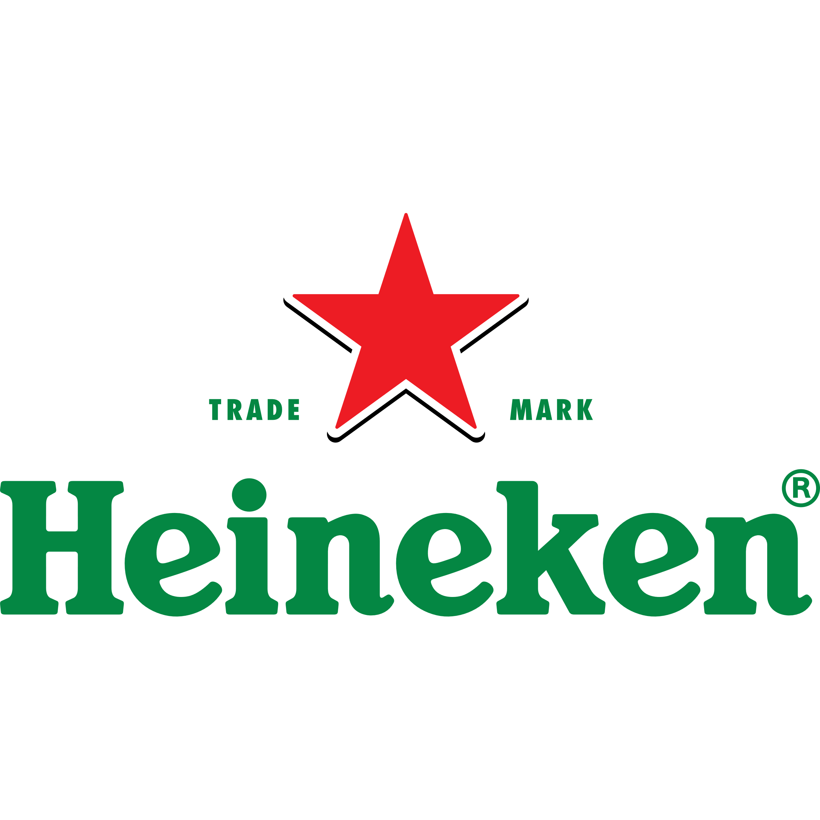


Logos

